Slide 1
Tissues of Fish

Slide 2
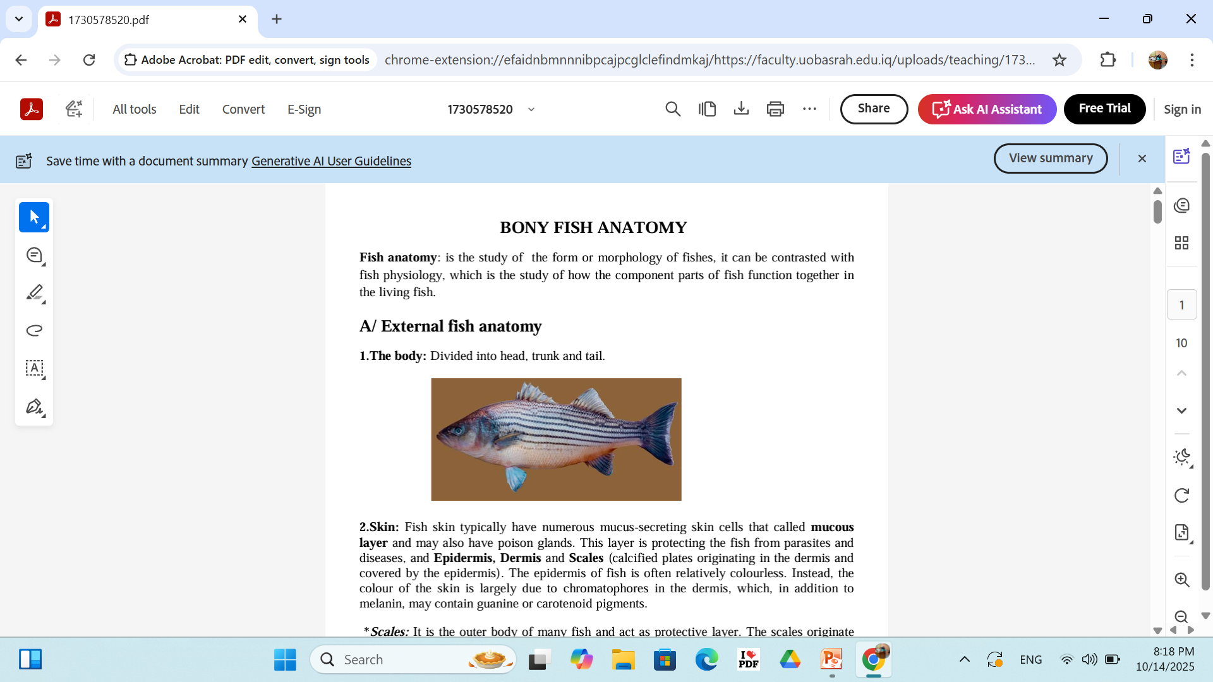
Fish anatomy
A/ External fish anatomy
1.The body: Divided into head, trunk and tail.
2. Skin: consisted of Epidermis, Dermis and Scales (calcified plates originating in the dermis and covered by the epidermis).
The epidermis: is colourless. Instead, the colour of the skin is largely due to chromatophores in the dermis, which, in addition to melanin, may contain guanine or carotenoid pigments.
Dermis: contains two strata spongiosum and compactum.
Cells:
1- Mucus-secreting cells that called mucous layer
2- poison glands:This layer is protecting the fish from parasites and diseases.

Slide 3
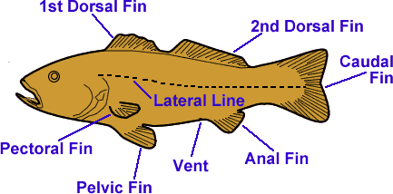
Fins
Tow types of Fins
single fins: the dorsal fin, anal fin, and tail fin.
paired fins: the pectoral fins and Pelvic fins.

Slide 4
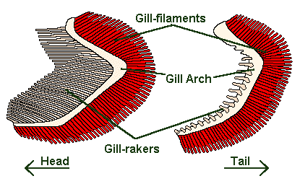
Gills:
Most fish have 4 gills on each side located under the operculum.
Gill are consisted of paired gill filaments, each filament consists of numerous lamellae. These filaments have many functions including the transfer of ions water, as well as the exchange of oxygen, carbon dioxide, acids and ammonia. Each filament contains a capillary network that provides a large surface area for exchanging.

Slide 5
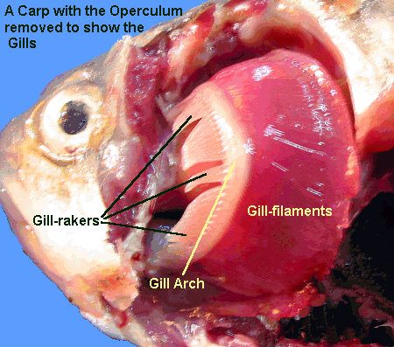
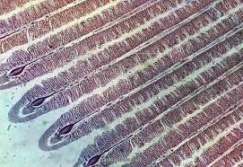
Gills
paired gill filaments is supported by a gill arch and protected by gill rakers, tooth-like projections that help make sure that no extraneous material gets into the gill filaments to clog them up (filter-feeders).

Slide 6
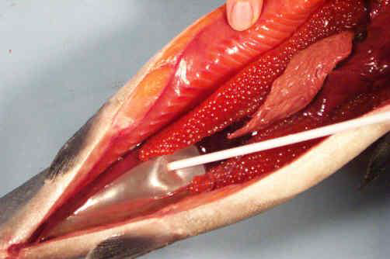
Swim bladder (Air bladder):
gas-filled balance organ that allows a fish to conserve energy by maintaining neutral buoyancy (suspending) in water. Fish caught from very deep water sometimes need to have air released from their swim bladder before they can be released and return to deep water, due to the difference in atmospheric pressure at the water's surface. Species of fish that do not possess a swim bladder sink to the bottom if they stop swimming.

Slide 7
Urinary system:
Kidney
Ureter
Urinary bladder

Slide 8
Kidney
Shape: It is a light or dark brown or black organ normally extending the length of the body cavity. It is usually divided into anterior or head kidney and posterior or excretory kidney. but this differentiation sometimes is not possible by external observations.

Slide 9
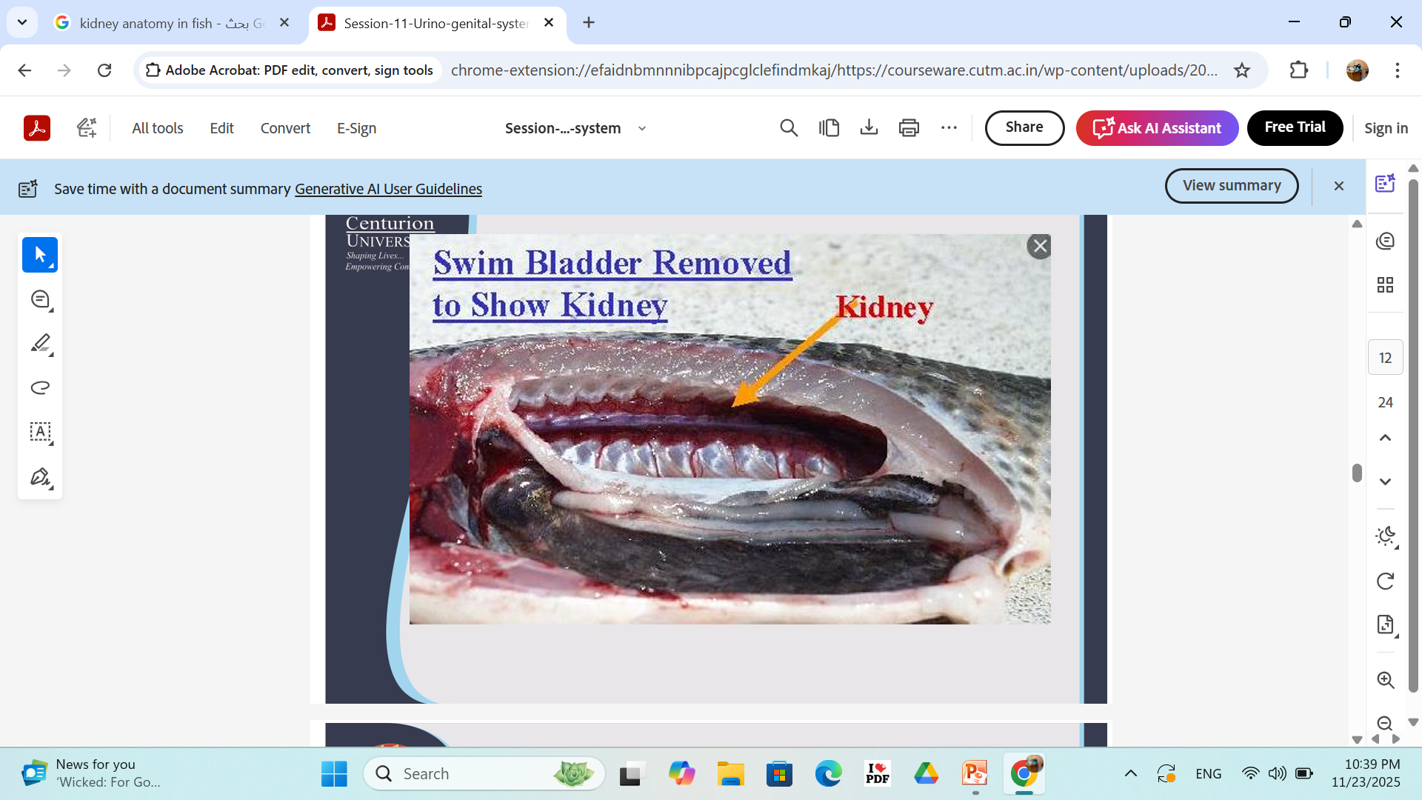

Slide 10
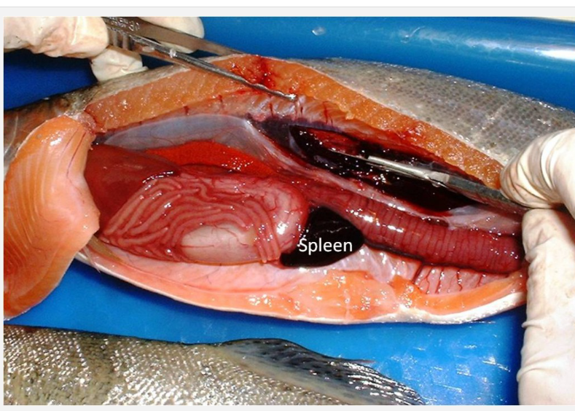

Slide 11
Functions
The kidney, the primary site for hematopoiesis in the fish, the hematopoietic tissue forms a support matrix for the nephrons of the posterior kidney but the anterior or head kidney is almost exclusively hematopoietic
osmotic regulation of water and salts rather than the excretion of nitrogenous wastes as in mammals.

Slide 12
The ureters
Function: which conduct urine from the collecting ducts to the urinary papilla.
The ureters may fuse at any level and may be dilated, after fusion, to form a bladder.

Slide 13
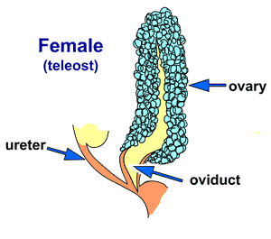
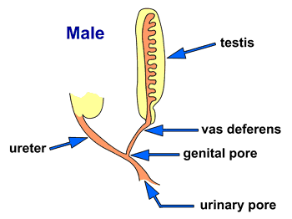
Reproductive system
Ovaries.
Testes.
Ovary
Testes

Slide 14
The tests
The testes are paired organs, suspended by mesenteries from the dorsal abdominal wall, alongside or below the swim bladder.
Histology: comprised of a series of tubules or blind sacs, the seminiferous tubules, which are lined with spermatogenic epithelium.
The process of maturation of the male gamete: involves the multiplication of spermatogonia which develop from the spermatogenic epithelium (primordial germ cell) to form spermatocytes. nourishing, cells of the seminiferous epithelium known as Sertoli cells until ready for release

Slide 15
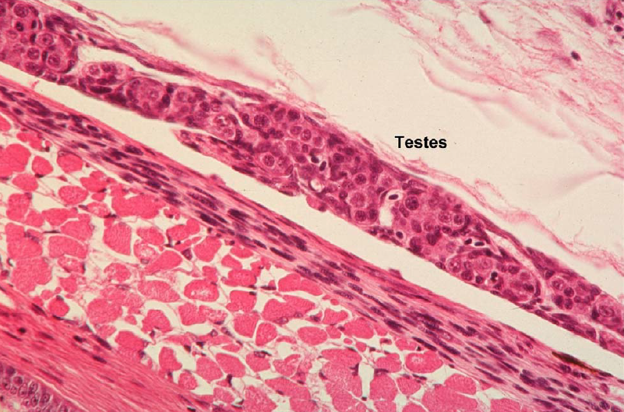

Slide 16
The ovary
The ovarian follicle is an aggregate of ova and epithelial cells.
These follicles start as oogonia, or primitive
egg mother cells, which are periodically generated in the germinal epithelium. The oogonia are made up of cells which are beginning to mature to form and produce oocytes. Small epithelial cells form a single layer surrounding the Oogonia. The epithelial cells grow as the ovum grows and are separated from it by a gradually thickening hyaline capsule. These are responsible for nourishing the ovum and secreting its yolk. In many species, several generations of ova may be found in different stages of development at one time

Slide 17
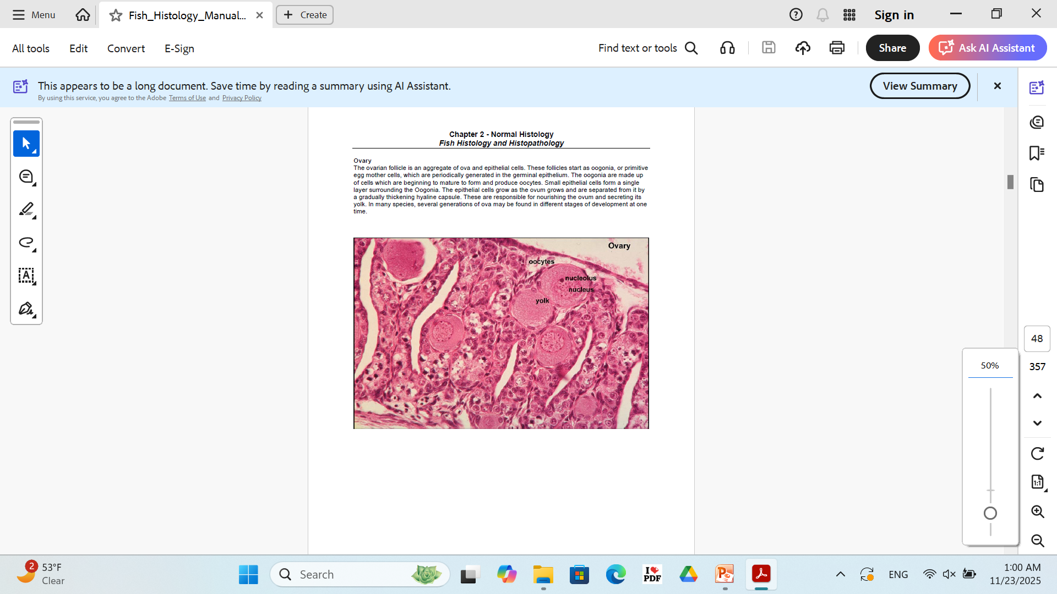

Slide 18
Tissues of Fish
Five basic tissues
1- Epithelial tissue للاطلاع
2- Connective tissues
3- Skeletal tissues
4- Muscular tissues

Slide 19
1- Epithelium
Consisted of
1- Contiguous cells
2- Small amount of intercellular matrix
Function
1- Lining cavities
2- Covering surface
3- Forms the essential parts of glands
Glands: Which are masses of cells specialized for secretion of a given product into the lumen of a duct or into a body of cavity, or into the blood or lymph stream.

Slide 20
Epithelial cells them are supported by basement membrane that separates them from the underlying connective tissues.
Types of cells:
Mucous-secreting cells.

Slide 21
Buccal cavity. The upper external surface is lined by a strafied epithelium and many cells (unicellular
glands - magenta) are located side by side at its surface. most of epithelial layer are usually cuboidal or columnar in shape and in contact with the basement membrane (black arrow). This one is mainly composed of glycosaminoglycans and (glyco)proteins and separates the epithelium from the underlying connective tissue (*).
The nuclei of the epidermal cells are stained blue (white arrows).

Slide 22
2- The connective tissues
The connective tissues: Are the a divers group of tissues that share a common origin from the mesenchyme of the embryo.
Function: Connecting and filling tissues.
Location: Lying beneath the epithelial tissues of the skin, of the digestive tract, of the tubular organs, between the muscles between the masses of secreting cells in the glands.

Slide 23
Structures of connective tissues
1- cells
2- Fibers
3- Extracellular matrix

Slide 24
Types of cells
Fixed cells
Fibroblast
Adipose cells
2- Free cells
Macrophage
plasma cells
mast cells

Slide 25
Types of connective tissues
Loose connective tissues
dense connective tissues
The adipose tissues
Ligament

Slide 26
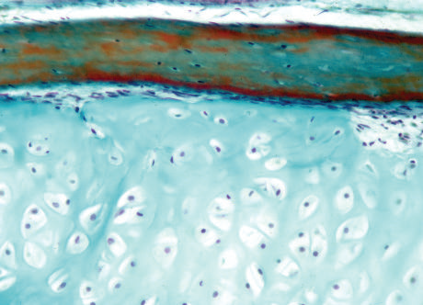
Hyaline cartilage takes up the largest part of this micrograph.
Cartilage is a semi-rigid form of skeletal tissue which contains neither blood vessels nor nerves.
Chondrocytes (whitsh with blue nuclei) are mature
cartilage cells scattered in an abundant extracellular matrix. This one (*) contains collagenous fibers (not
visible) and a predominant ground substance. The
lamella of cartilage shown here is lined by a thin perichondrium

Slide 27
Muscular tissues
Types of muscular tissues
Smooth
cardiac
Skeletal

Slide 28
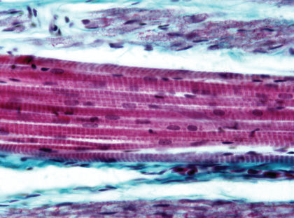
Skeletal muscle. This micrograph illustrates some characteristic histological features of skeletal muscle
fibers cut longitudinally. About ten unbranched and elongated fibers are shown at the center of the micrograph.
Rhabdomyocytes are multinucleate cells
whose flattened nuclei (arrows) are located at the periphery, just beneath the plasma membrane (sarcolemma).
Regular cross-striations (A and I bands)
are characterize. The muscle fibers are grouped together into bundles (fasciculi) surrounded by loose
collagenous tissue ( perimysium - in turquoise).

Slide 29
Nervous tissues
Cells have ability to receive and transmit stimuli
Divisions of the nervous system
Central nervous system
2. Peripheral nervous system
Brain
Spinal cord
Cranial
Spinal nerves

